Slide 1

Chapter 2
Application Layer
2.
.

Slide 2
Chapter 2: Outline
2.1 INTRODUCTION
2.2 CLIENT-SERVER PARADIGM
2.3 STANDARD APPLICATIONS
2.4 PEER-TO-PEER PARADIGM
2.5 SOCKET-INTERFACE PROGRAMMING
2.

Slide 3
Chapter 2: Objective
We introduce the nature of services provided by the Internet: the client-server paradigm and the peer-to-peer paradigm.
We discuss the concept of the client-server paradigm.
We discuss some predefined or standard applications based on the client-server paradigm such as surfing the Web, file transfer, e-mail, and so on.
We discuss the concept and protocols in the peer-to-peer paradigm such as Chord, Pastry, and Kademlia.
We show how a new application can be created in the client-server paradigm by writing two programs in the C language.
2.

Slide 4
2-1 INTRODUCTION
The application layer provides services to the user. Communication is provided using a logical connection, which means that the two application layers assume that there is an imaginary direct connection through which they can send and receive messages. Figure 2.1 shows the idea behind this logical connection.
2.

Slide 5
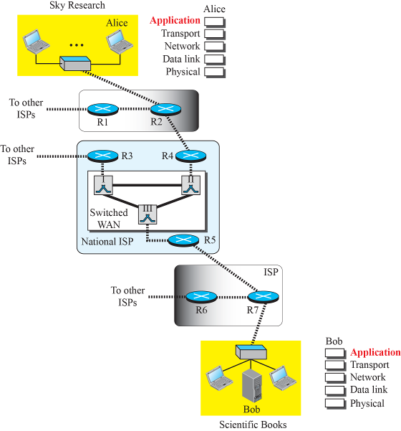

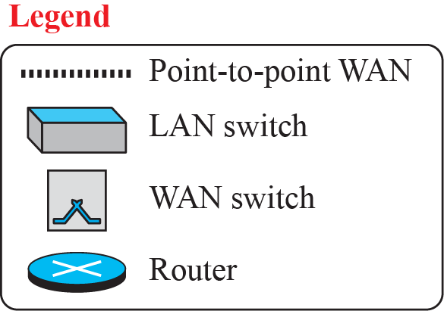
Figure 2.1: Logical connection at the application layer
2.

Slide 6
2.1.1 Providing Services
The Internet was originally designed to provide service to users around the world. Since the application layer is the only layer that provides services to the Internet user, it allows new application protocols to be easily added to the Internet, which has been occurring during the lifetime of the Internet. When the Internet was created, only a few application protocols were available to the users; today we cannot give a number for these protocols because new ones are being added constantly.
2.

Slide 7
2.1.1 Providing Services (Cont.)
Standard and Nonstandard Protocols
Standard Application-Layer Protocols
Nonstandard Application-Layer Protocols
2.

Slide 8
2.1.2 Application-Layer Paradigm
It should be clear that to use the Internet we need two application programs to interact with each other: one running on a computer somewhere in the world, the other running on another computer somewhere else in the world. The two programs need to send messages to each other through the Internet infrastructure. However, we have not discussed what the relationship should be between these programs. Should both application programs be able to request services and provide services, or should the application programs just do one or the other?
2.

Slide 9
2.1.2 Application-Layer Paradigm (cont)
Traditional Paradigm: Client-Server
New Paradigm: Peer-to-Peer
Mixed Paradigm
2.

Slide 10

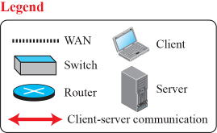
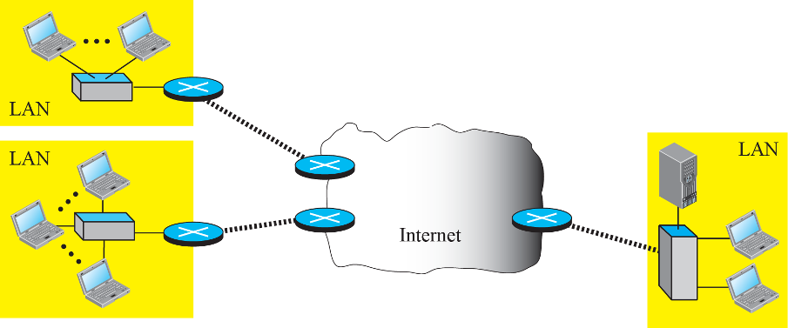
Figure 2.2: Example of a client-server paradigm
2.

Slide 11
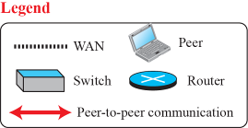
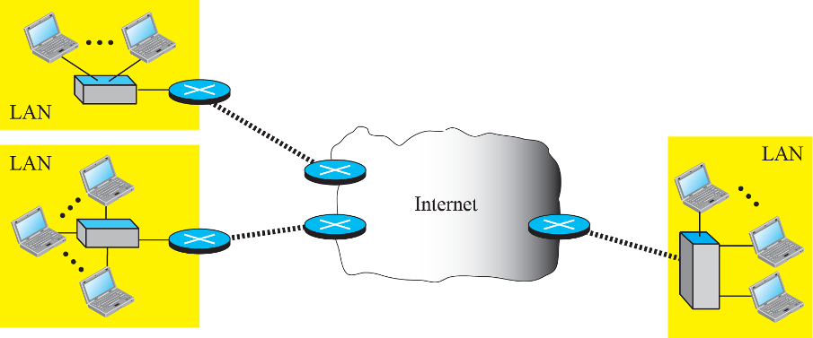
Figure 2.3: Example of a peer-to-peer paradigm
2.

Slide 12
2-2 CLIENT-SERVER PARADIGM
In this paradigm, communication at the application layer is between two running application programs called processes: a client and a server. A client is a running program that initializes the communication by sending a request; a server is another application program that waits for a request from a client.
2.

Slide 13
2.2.1 Application Programming Interface
A computer language has a set of instructions for mathematical operations, a set of instructions for string manipulation, a set of instructions for input/ output access, and so on. If we need a process to be able to communicate with another process, we need a new set of instructions to tell the lowest four layers of the TCP/IP suite to open the connection, send and receive data from the other end, and close the connection. A set of instructions of this kind is normally referred to as Application Programming Interface (API).
2.

Slide 14
2.2.1 (continued)
Sockets
Socket Addresses
Finding Socket Addresses
Server Site
Client Site
2.

Slide 15
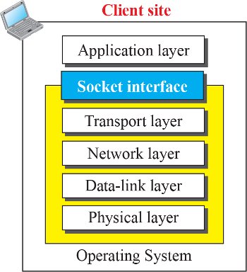
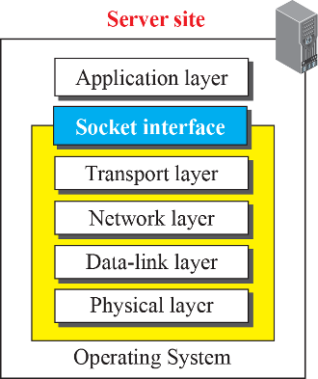
Figure 2.4: Position of the socket interface
2.

Slide 16


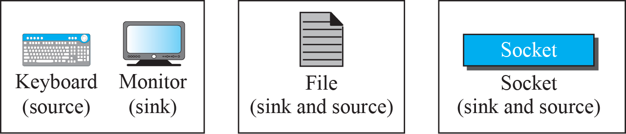
Figure 2.5: A Sockets used like other sources and sinks
2.

Slide 17
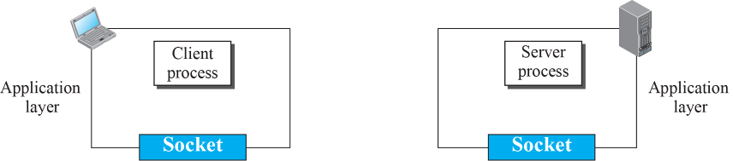
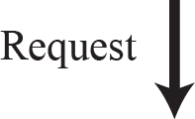
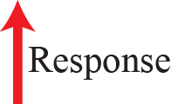
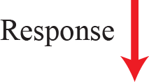
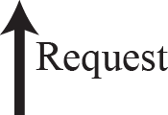

Figure 2.6: Use of sockets in process-to-process communication
2.

Slide 18
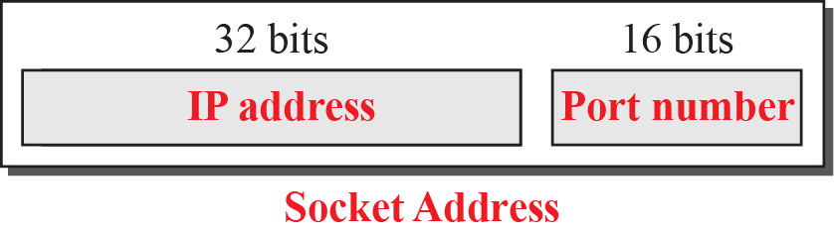
Figure 2.7: A socket address
2.

Slide 19
Example 2.1
We can find a two-level address in telephone communication. A telephone number can define an organization, and an extension can define a specific connection in that organization. The telephone number in this case is similar to the IP address, which defines the whole organization; the extension is similar to the port number, which defines the particular connection.
2.

Slide 20
2.2.2 Using Services of Transport Layer
A pair of processes provide services to the users of the Internet, human or programs. A pair of processes, however, need to use the services provided by the transport layer for communication because there is no physical communication at the application layer. There are three common transport layer protocols in the TCP/IP suite: UDP, TCP, and SCTP.
UDP Protocol
TCP Protocol
SCTP Protocol
2.

Slide 21
2-3 STANDARD CLIENT-SERVER APPLICATIONS
During the lifetime of the Internet, several application programs have been developed. We do not have to redefine them, but we need to understand what they do. For each application, we also need to know the options available to us. The study of these applications can help us to create customized applications in the future.
2.

Slide 22
2.3.1 World Wide Web and HTTP
In this section, we first introduce the World Wide Web (abbreviated WWW or Web). We then discuss the Hyper Text Transfer Protocol (HTTP), the most common client-server application program used in relation to the Web.
2.

Slide 23
2.3.1 (continued)
World Wide Web
Architecture
Uniform Resource Locator (URL)
Web Documents
HyperText Transfer Protocol (HTTP)
Nonpersistent versus Persistent Connections
Message Formats
Conditional Request
Cookies
2.

Slide 24
2.3.1 (continued)
Web Caching: Proxy Server
Proxy Server Location
Cache Update
HTTP Security
2.

Slide 25
Example 2.2
Assume we need to retrieve a scientific document that contains one reference to another text file and one reference to a large image. Figure 2.8 shows the situation.
The main document and the image are stored in two separate files in the same site (file A and file B); the referenced text file is stored in another site (file C). Since we are dealing with three different files, we need three transactions if we want to see the whole document.
2.

Slide 26






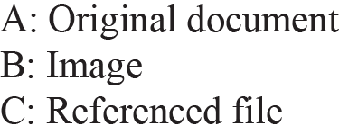





Figure 2.8: Example 2.2 (Retrieving two files and one image
2.

Slide 27
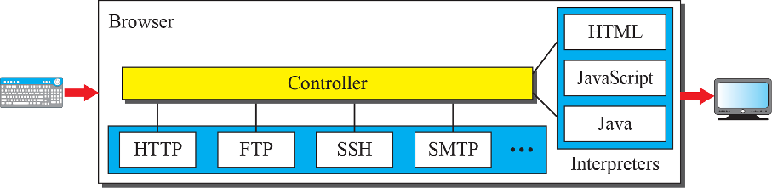
Figure 2.9: Browser
2.

Slide 28
Example 2.3
The URL http://www.mhhe.com/compsci/forouzan/ defines the web page related to one of the of the computer in the McGraw-Hill company (the three letters www are part of the host name and are added to the commercial host). The path is compsci/forouzan/, which defines Forouzan’s web page under the directory compsci (computer science).
2.

Slide 29
Example 2.4
Figure 2.10 shows an example of a nonpersistent connection. The client needs to access a file that contains one link to an image. The text file and image are located on the same server. Here we need two connections. For each connection, TCP requires at least three handshake messages to establish the connection, but the request can be sent with the third one. After the connection is established, the object can be transferred. After receiving an object, another three handshake messages are needed to terminate the connection, as we will see in Chapter 3.
2.

Slide 30
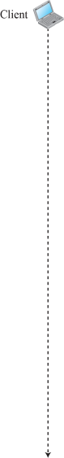
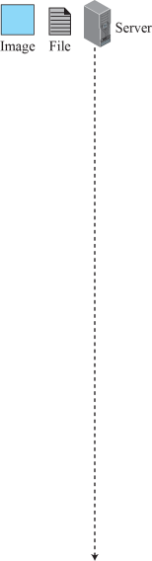
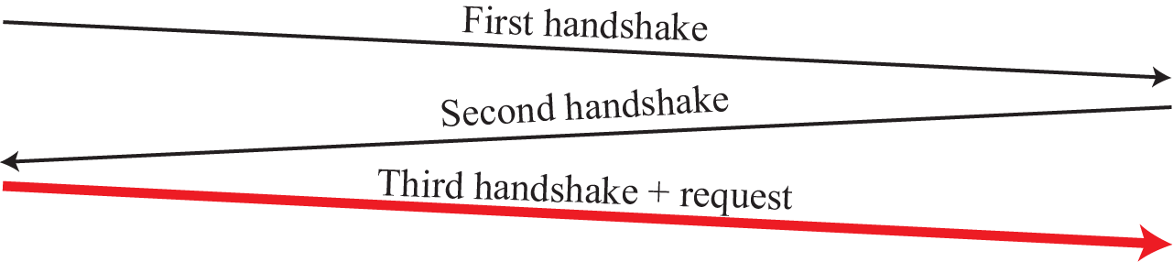

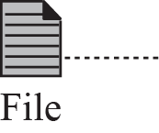
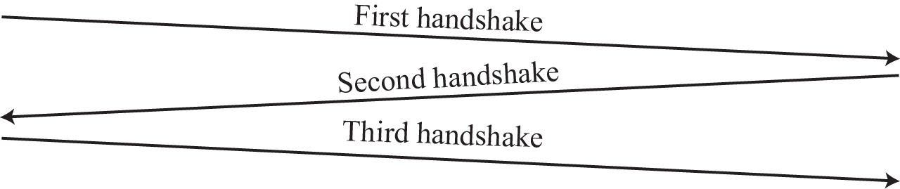

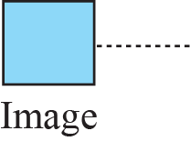
Figure 2.10: Example 2.4
2.

Slide 31
Example 2.5
Figure 2.11 shows the same scenario as in Example 2.4, but using a persistent connection. Only one connection establishment and connection termination is used, but the request for the image is sent separately.
2.

Slide 32
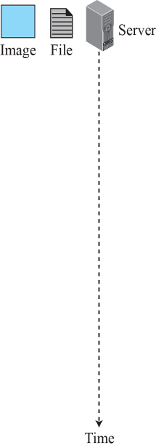

Figure 2.11: Example 2.5
2.

Slide 33
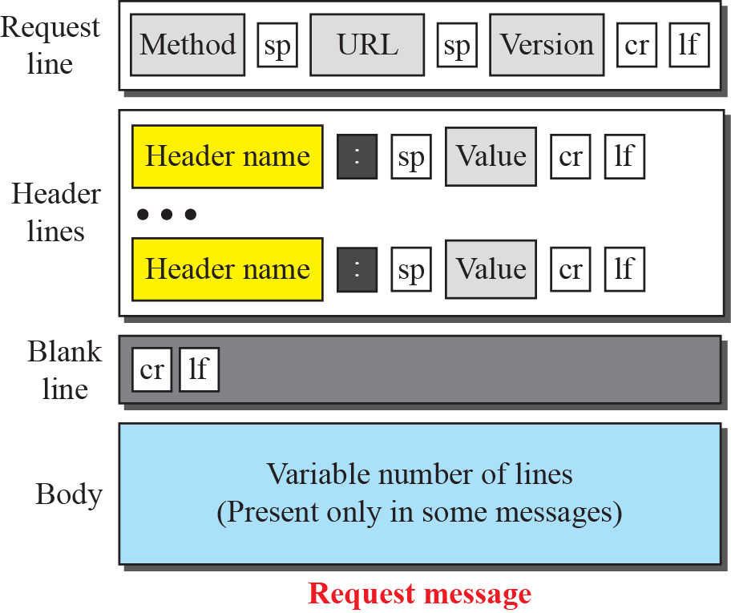
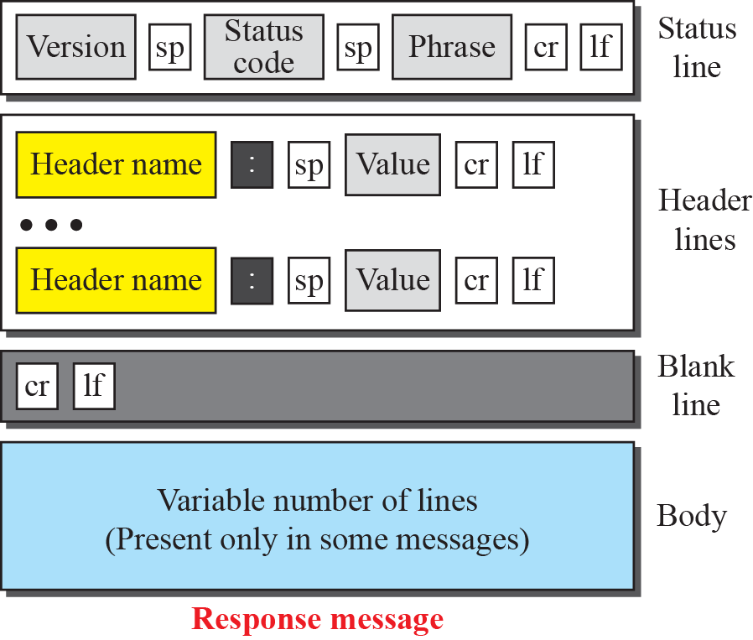
Figure 2.12: Formats of the request and response messages
2.

Slide 34
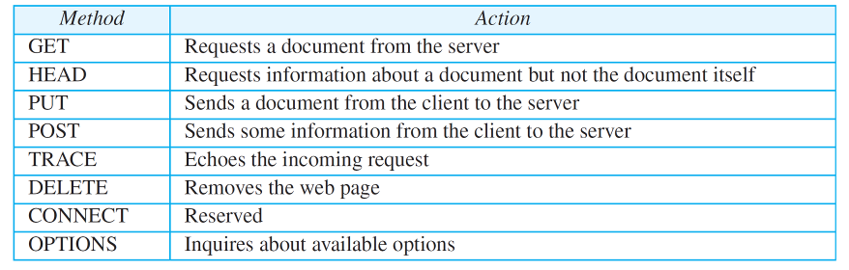
Table 2.1: Methods
2.

Slide 35
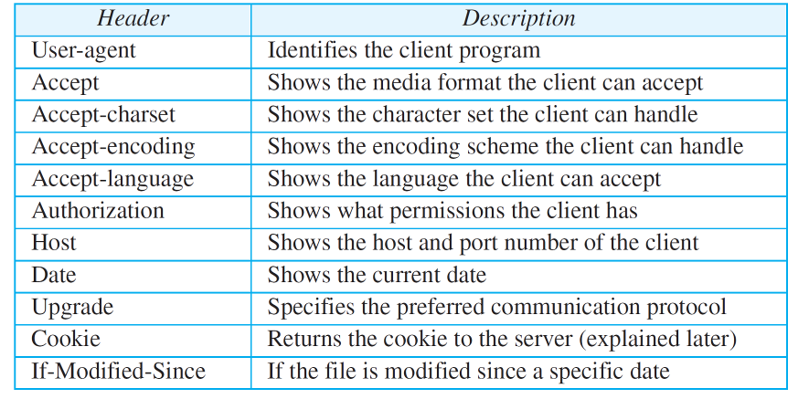
Table 2.2: Request Header Names
2.

Slide 36
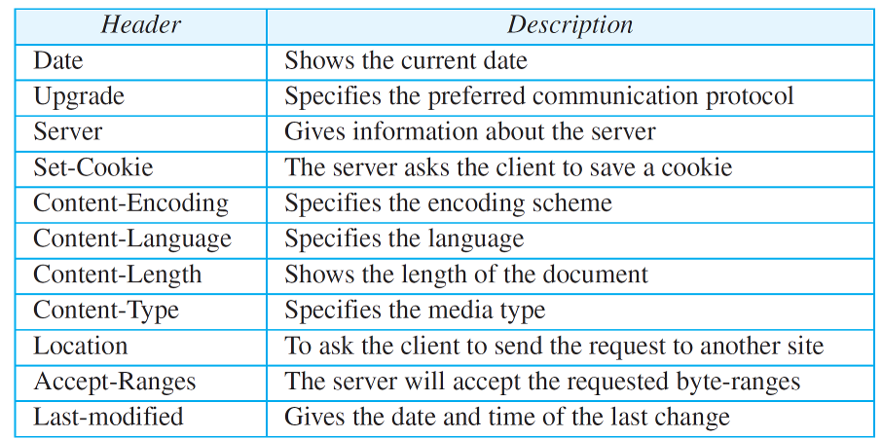
Table 2.3: Response Header Names
2.

Slide 37
Example 2.6
This example retrieves a document (see Figure 2.13). We use the GET method to retrieve an image with the path /usr/bin/image1. The request line shows the method (GET), the URL, and the HTTP version (1.1). The header has two lines that show that the client can accept images in the GIF or JPEG format. The request does not have a body. The response message contains the status line and four lines of header. The header lines define the date, server, content encoding (MIME version, which will be described in electronic mail), and length of the document. The body of the document follows the header..
2.

Slide 38
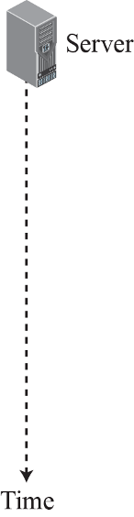
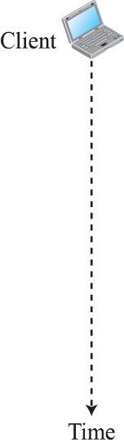
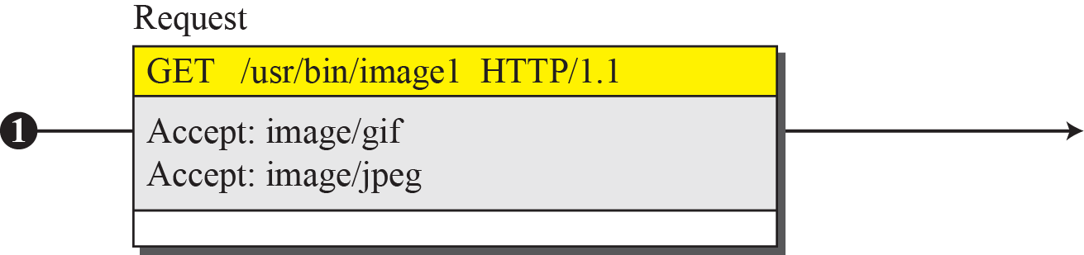
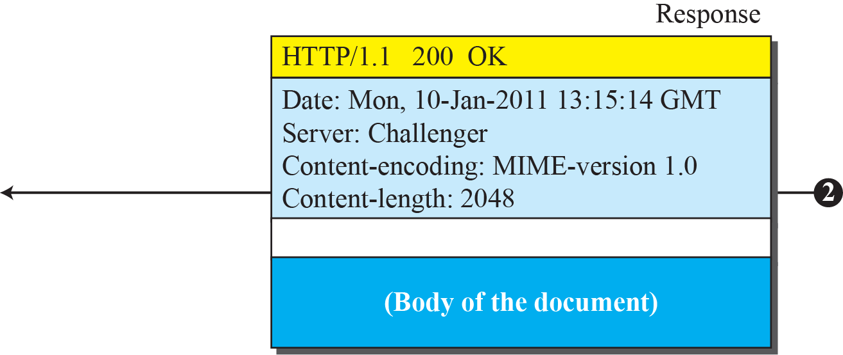
Figure 2.13: Example 2.6
2.

Slide 39
Example 2.7
In this example, the client wants to send a web page to be posted on the server. We use the PUT method. The request line shows the method (PUT), URL, and HTTP version (1.1). There are four lines of headers. The request body contains the web page to be posted. The response message contains the status line and four lines of headers. The created document, which is a CGI document, is included as the body (see Figure 2.14).
2.

Slide 40
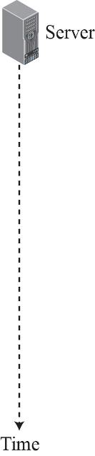
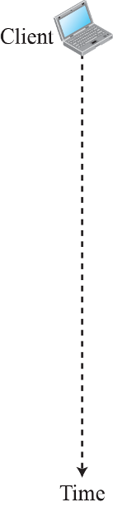
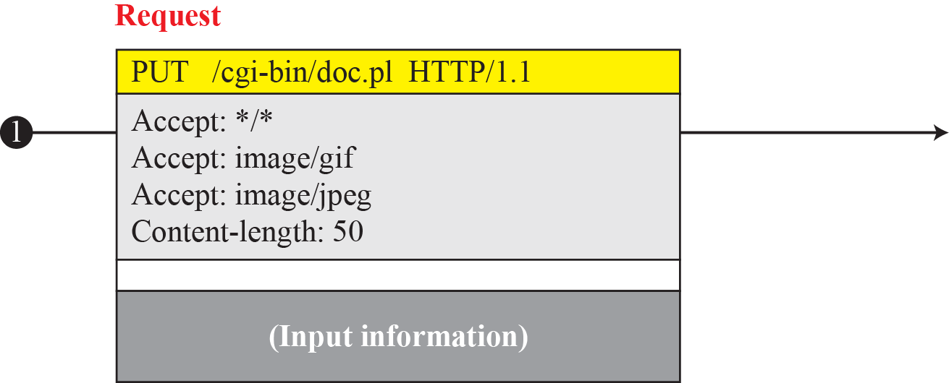
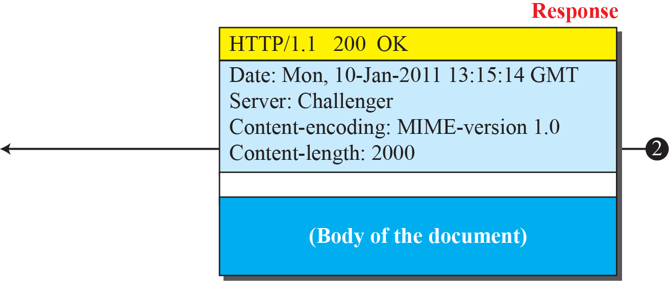
Figure 2.14: Example 2.7
2.

Slide 41
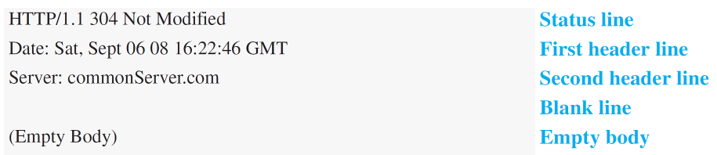
Example 2.8
The following shows how a client imposes the modification data and time condition on a request.
The status line in the response shows the file was not modified after the defined point in time. The body of the response message is also empty.
2.

Slide 42
Example 2.9
Figure 2.15 shows a scenario in which an electronic store can benefit from the use of cookies. Assume a shopper wants to buy a toy from an electronic store named BestToys. The shopper browser (client) sends a request to the BestToys server. The server creates an empty shopping cart (a list) for the client and assigns an ID to the cart (for example, 12343). The server then sends a response message, which contains the images of all toys available, with a link under each toy that selects the toy if it is being clicked. This response message also includes the Set-Cookie header line whose value is 12343. The client displays the images and stores the cookie value in a file named BestToys.
2.

Slide 43
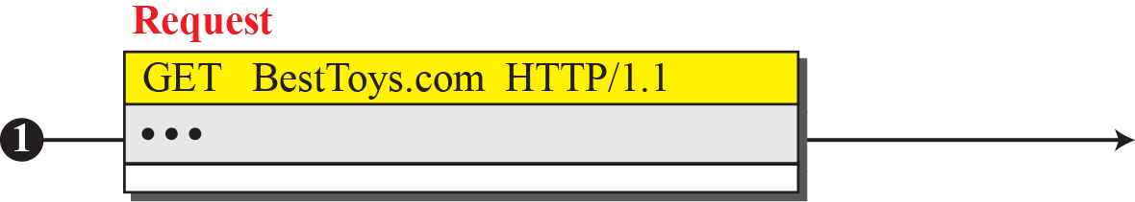
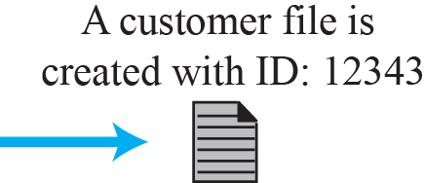
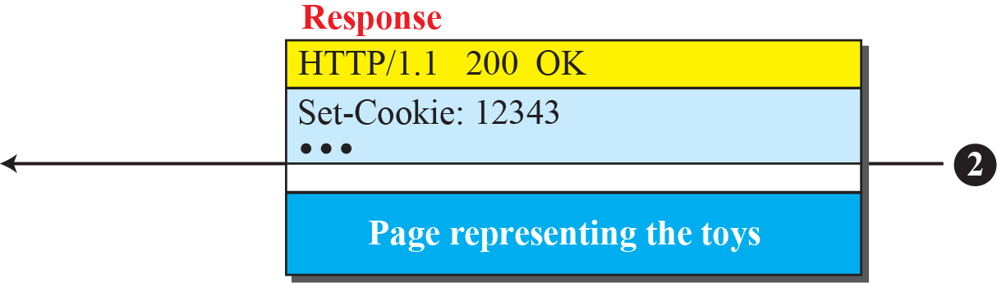
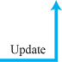
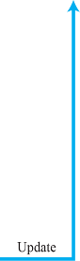
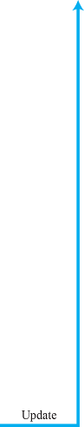
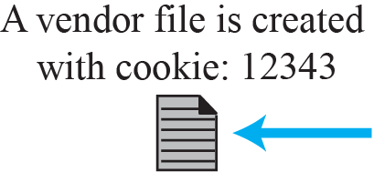


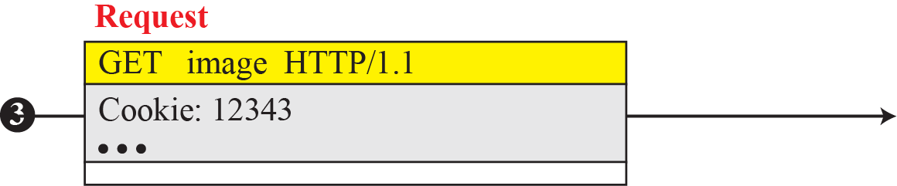
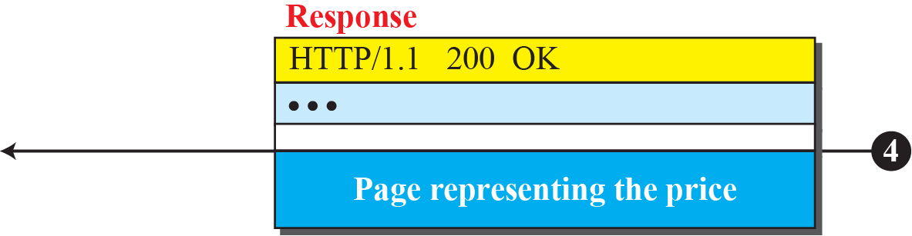
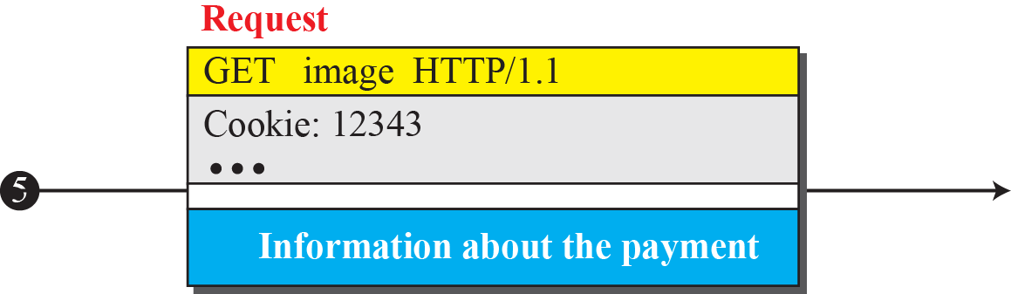
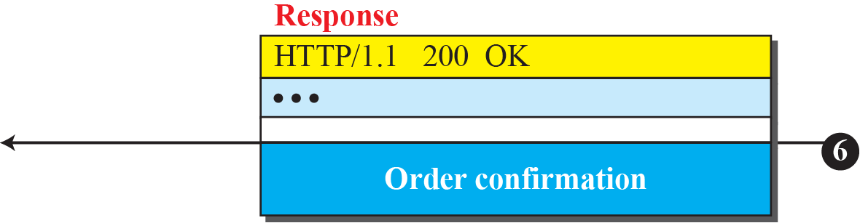
Figure 2.15: Example 2.9
2.

Slide 44
Example 2.10
Figure 2.16 shows an example of a use of a proxy server in a local network, such as the network on a campus or in a company. The proxy server is installed in the local network. When an HTTP request is created by any of the clients (browsers), the request is first directed to the proxy server If the proxy server already has the corresponding web page, it sends the response to the client. Otherwise, the proxy server acts as a client and sends the request to the web server in the Internet. When the response is returned, the proxy server makes a copy and stores it in its cache before sending it to the requesting client.
2.

Slide 45
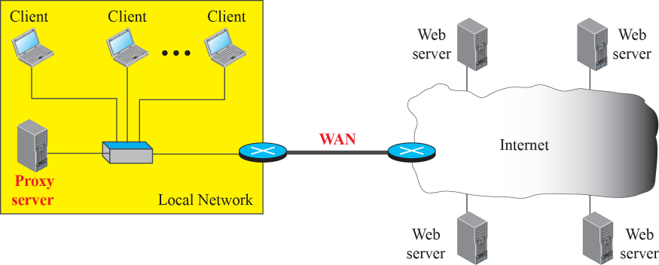
Figure 2.16: Example of a proxy server
2.

Slide 46
2.3.3 Electronic Mail
Electronic mail (or e-mail) allows users to exchange messages. The nature of this application, however, is different from other applications discussed so far. In an application such as HTTP or FTP, the server program is running all the time, waiting for a request from a client. When the request arrives, the server provides the service. In the case of electronic mail, the situation is different.
2.

Slide 47
2.3.3 Continued
First, e-mail is considered a one-way transaction. When Alice sends an e-mail to Bob, she may expect a response, but this is not a mandate. Bob may or may not respond. If he does respond, it is another one-way transaction. Second, it is neither feasible nor logical for Bob to run a server program and wait until someone sends an e-mail to him. Bob may turn off his computer when he is not using it. This means that the idea of client/ server programming should be implemented in another way: using some intermediate computers (servers).
2.

Slide 48
2.3.3 (continued)
Architecture
User Agent
Sending Mail
Receiving Mail
Addresses
Mailing List or Group List
2.

Slide 49
2.3.1 (continued)
MIME
MIME Headers
Web-Based Mail
Case I
Case II
E-Mail Security
2.

Slide 50
2.3.1 (continued)
Message Transfer Agent: SMTP
Commands and Responses
Mail Transfer Phases
Message Access Agent: POP and IMAP
POP3
IMAP4
2.

Slide 51


Figure 2.19: Common scenario
2.

Slide 52




Figure 2.20: Format of an e-mail
2.

Slide 53



Figure 2.21: E-mail address
2.

Slide 54




Figure 2.22: Protocols used in electronic mail
2.

Slide 55

Table 2.6: SMTP Commands
2.

Slide 56

Table 2.7: SMTP responses
2.

Slide 57

Table 2.7: SMTP responses (continued)
2.

Slide 58
Example 2.13
To show the three mail transfer phases, we show all of the steps described above using the information depicted in Figure 2.23. In the figure, we have separated the messages related to the envelope, header, and body in the data transfer section. Note that the steps in this figure are repeated two times in each e-mail transfer: once from the e-mail sender to the local mail server and once from the local mail server to the remote mail server. The local mail server, after receiving the whole e-mail message, may spool it and send it to the remote mail server at another time.
2.

Slide 59










Figure 2.23: Example 2.13
2.

Slide 60


Figure 2.24: POP3
2.

Slide 61




Figure 2.25: MIME
2.

Slide 62

Figure 2.26: MIME header
2.

Slide 63

Table 2.8: Data Types and Subtypes in MIME
2.

Slide 64

Table 2.9: Methods for Content-Transfer-Encoding
2.

Slide 65




Figure 2.27: Base64 conversion
2.

Slide 66

Table 2.10: Base64 Converting Table
2.

Slide 67


Figure 2.28: Quoted-printable
2.

Slide 68


Figure 2.29: Web-based e-mail, cases I and II
2.

Slide 69
2.3.6 Domain Name System (DNS)
To identify an entity, TCP/IP protocols use the IP address, which uniquely identifies the connection of a host to the Internet. However, people prefer to use names instead of numeric addresses. Therefore, the Internet needs to have a directory system that can map a name to an address. This is analogous to the telephone network. A telephone network is designed to use telephone numbers, not names. People can either keep a private file to map a name to the corresponding telephone number or can call the telephone directory to do so.
2.

Slide 70
2.3.6 (continued)
Name Space
Domain Name Space
Domain
Distribution of Name Space
Zone
Root Server
DNS in the Internet
Generic Domains
Country Domains
2.

Slide 71
2.3.1 (continued)
Resolution
Recursive Resolution
Iterative Resolution
Caching
Resource Records
DNS Messages
Encapsulation
Registrars
DDNS
Security of DNS
2.

Slide 72










Figure 2.35: Purpose of DNS
2.

Slide 73

Figure 2.36: Domain name space
2.

Slide 74





Figure 2.37: Domain names and labels
2.

Slide 75



Figure 2.38: Domains
2.

Slide 76

Figure 2.39: Hierarchy of name servers
2.

Slide 77

Figure 2.40: Zone
2.

Slide 78

Figure 2.41: Generic domains
2.

Slide 79


Table 2.12: Generic domain labels
2.

Slide 80

Figure 2.42: Country domains
2.

Slide 81








Figure 2.43: Recursive resolution
2.

Slide 82
Figure 2.44: Iterative resolution
2.

Slide 83

Table 2.13: DNS types
2.

Slide 84



Figure 2.45: DNS message
2.

Slide 85

Example 2.14
In UNIX and Windows, the nslookup utility can be used to retrieve address/name mapping. The following shows how we can retrieve an address when the domain name is given.
2.

Slide 86
2-4 PEER-TO-PERR PARADIGM
In this section, we discuss the peer-to peer paradigm. Peer-to-peer gained popularity with Napster, an online music file. Napster paved the way for peer-to-peer file-distribution models that came later. Gnutella was followed by Fast-
Track, BitTorrent, WinMX, and GNUnet.
2.

Slide 87
2.4.1 P2P Networks
Internet users that are ready to share their resources become peers and form a network. When a peer in the network has a file) to share, it makes it available to the rest of the peers. An interested peer can connect itself to the computer where the file is stored and download it. After a peer downloads a file, it can
make it available for other peers to download. As more peers join and download that file, more copies of the file become available to the group.
2.

Slide 88
2.4.1 (continued)
Centralized Networks
Decentralized Network
Unstructured Networks
Structured Networks
2.

Slide 89


Figure 2.46: Centralized network
2.

Slide 90
2.4.2 Distributed Hash Function
A Distributed Hash Table (DHT) distributes data among a set of nodes according to some predefined rules. Each peer in a DHT-based network becomes responsible for a range of data items. To avoid the flooding overhead that we discussed for unstructured P2P networks, DHT-based networks allow each peer to have a partial knowledge about the whole network. This knowledge can be used to route the queries about the data items to the responsible nodes using effective and scalable procedures.
2.

Slide 91
2.4.2 (continued)
Address Space
Hashing Peer Identifier
Hashing Object Identifier
Storing the Object
Routing
Arrival and Departure of Nodes
2.

Slide 92


Figure 2.47: Address space
2.

Slide 93
Example 2.15
Although the normal value of m is 160, for the purpose of demonstration, we use m = 5 to make our examples tractable. In Figure 2.48, we assume that several peers have already joined the group. The node N5 with IP address 110.34.56.20 has a file named Liberty that wants to share with its peers. The node makes a hash of the file name, “Liberty,” to get the key = 14. Since the closest node to key 14 is node N17, N5 creates a reference to file name (key), its IP address, and the port number (and possibly some other information about the file) and sends this reference to be stored in node N17. In other words, the file is stored in N5, the key of the file is k14 (a point in the DHT ring), but the reference to the file is stored in node N17.
2.

Slide 94


Figure 2.48: Example 2.15
2.

Slide 95
2-5 SOCKET-INTERFACE PROGRAMMING
In this section, we show how to write some simple client-server programs using C, a procedural programming language. We chose the C language in this section; In Chapter 11, we expand this idea in Java, which provides a more compact version.
2.

Slide 96
2.5.1 Socket Interface in C
In this section, we show how this interface is implemented in the C language. The important issue in socket interface is to understand the role of a socket in communication. The socket has no buffer to store data to be sent or received. It is capable of neither sending nor receiving data. The socket just acts as a reference or a label. The buffers and necessary variables are created inside the operating system.
2.

Slide 97
2.5.1 (continued)
Data Structure for Socket
Header Files
Communication Using UDP
Sockets Used for UDP
Communication Flow Diagram
Programming Examples
Communication Using TCP
Sockets Used in TCP
Communication Flow Diagram
2.

Slide 98


Figure 2.58: Socket data structure
2.

Slide 99



Figure 2.59: Sockets for UDP communication
2.

Slide 100









Figure 2.60: Flow diagram for iterative UDP communication
2.

Slide 101


Table 2.22: Echo server program using UDP
2.

Slide 102

Table 2.22: Echo server program using UDP (continued)
2.

Slide 103

Table 2.23: Echo client program using UDP
2.

Slide 104

Table 2.23: Echo client program using UDP (continued)
2.

Slide 105

Table 2.23: Echo client program using UDP (continued)
2.

Slide 106





Figure 2.61: Sockets used in TCP communication
2.

Slide 107












Figure 2.62: Flow diagram for iterative TCP communication
2.

Slide 108


Figure 2.63: Flow diagram for data-transfer boxes
2.

Slide 109



Figure 2.64: Buffer used for receiving
2.

Slide 110

Table 2.24: Echo server program using the services of TCP
2.

Slide 111


Table 2.24: TCP Echo server program(continued)
2.

Slide 112

Table 2.24: TCP Echo server program (continued)
2.

Slide 113

Table 2.25: Echo client program using the services of TCP
2.

Slide 114

Table 2.25: TCP Echo client program (continued)
2.

Slide 115

Table 2.24: TCP Echo client program(continued)
2.

Slide 116
Chapter 2: Summary
Applications in the Internet are designed using either a client-server paradigm or a peer-to-peer paradigm. In a client-server paradigm, an application program, called a server, provides services and another application program, called a client, receives services. A server program is an infinite program; a client program is finite. In a peer-to- peer paradigm, a peer can be both a client and a server.
The World Wide Web (WWW) is a repository of information linked together from points all over the world. Hypertext and hypermedia documents are linked to one another through pointers. The HyperText Transfer Protocol (HTTP) is the main protocol used to access data on the World Wide Web (WWW).
2.

Slide 117
Chapter 2: Summary (continued)
File Transfer Protocol (FTP) is a TCP/IP client-server application for copying files from one host to another. FTP requires two connections for data transfer: a control connection and a data connection. FTP employs NVT ASCII for communication between dissimilar systems.
Electronic mail is one of the most common applications on the Internet. The e-mail architecture consists of several components such as user agent (UA), main transfer agent (MTA), and main access agent (MAA). The protocol that implements MTA is called Simple Main Transfer Protocol (SMTP). Two protocols are used to implement MAA: Post Office Protocol, version 3 (POP3) and Internet Mail Access Protocol, version 4 (IMAP4).
2.

Slide 118
Chapter 2: Summary (continued)
File Transfer Protocol (FTP) is a TCP/IP client-server application for copying files from one host to another. FTP requires two connections for data transfer: a control connection and a data connection. FTP employs NVT ASCII for communication between dissimilar systems.
TELNET is a client-server application that allows a user to log into a remote machine, giving the user access to the remote system. When a user accesses a remote system via the TELNET process, this is comparable to a time-sharing environment.
2.

Slide 119
Chapter 2: Summary (continued)
The Domain Name System (DNS) is a client-server application that identifies each host on the Internet with a unique name. DNS organizes the name space in a hierarchical structure to decentralize the responsibilities involved in naming. TELNET is a client-server application that allows a user to log into a remote machine, giving the user access to the remote system.
In a peer-to-peer network, Internet users that are ready to share their resources become peers and form a network. Peer-to-peer networks are divided into centralized and decentralized.
2.

